Slide 1
Azure AI Search L100 Deck

Slide 2


Agenda
RAG overview (optional)
About Azure AI Search
Building high quality applications
Developer and team agility
Enterprise RAG systems at scale
Momentum
What’s new
Notes:
Today we are going to talk about how to build scalable, production ready GenAI apps with your own data.

Slide 3








Retrieval-augmented generation
Retrieval system
Data Sources
User question
Answer
App UX
Orchestrator
Large Language Model
Notes:
But first, we need to frame the conversation and talk about retrieval augmented generation, and how it fits into the GenAI stack.
A common way to describe RAG is that you are “grounding” your AI application with your data.
If you are building an app using an AI model, you probably want to create an experience based on your own data, versus public web data. RAG is a way to incorporate your data into your GenAI application.
Out of the box, an AI model has a limited set of knowledge. RAG enables your app to learn new facts or knowledge outside what the model was originally trained on. This way, your app isn’t limited to a static/outdated dataset.
An important point to note, that with RAG, the knowledge you provide is externalized, and not incorporated into the model itself. This ensures you remain in control of your data, at all times.
When implementing RAG, a critical component is the "Retrieval system" which surfaces the right information from your data, that's needed to answer any particular question or interaction.
From there, you use the language model like Azure OpenAI GPT to apply reasoning and produce a relevant response.
When customers build their GenAI applications, Azure AI Search is used as the "retrieval system" in their RAG stack.

Slide 4
Bring domain knowledge to LLMs
Prompt engineering
In-context learning
Fine tuning
Learn new skills
Retrieval augmentation
Learn new facts
Notes:
There are generally three ways to apply domain knowledge and share your data with an AI model. RAG is not always the answer.
Sometimes you can get the job done by simply doing prompt engineering. Prompt engineering is about providing fixed information relevant to the task at hand, or specific prompt. This method is helpful when you have a static situation and a single prompt that you can work on until it gives you the answers you want and then you are set. As models evolve, it’s possible to provide more and more information into a prompt.
Other times, fine-tuning is the best approach. It’s not necessarily the best method for learning facts, but it’s really good when you need your app to learn skills, for example, like company jargon, providing a different “tone” of response, etc.
Now, when it comes to learning facts, based on data that your application or your organization produces, retrieval-augmentation is the pattern to go for.

Slide 5

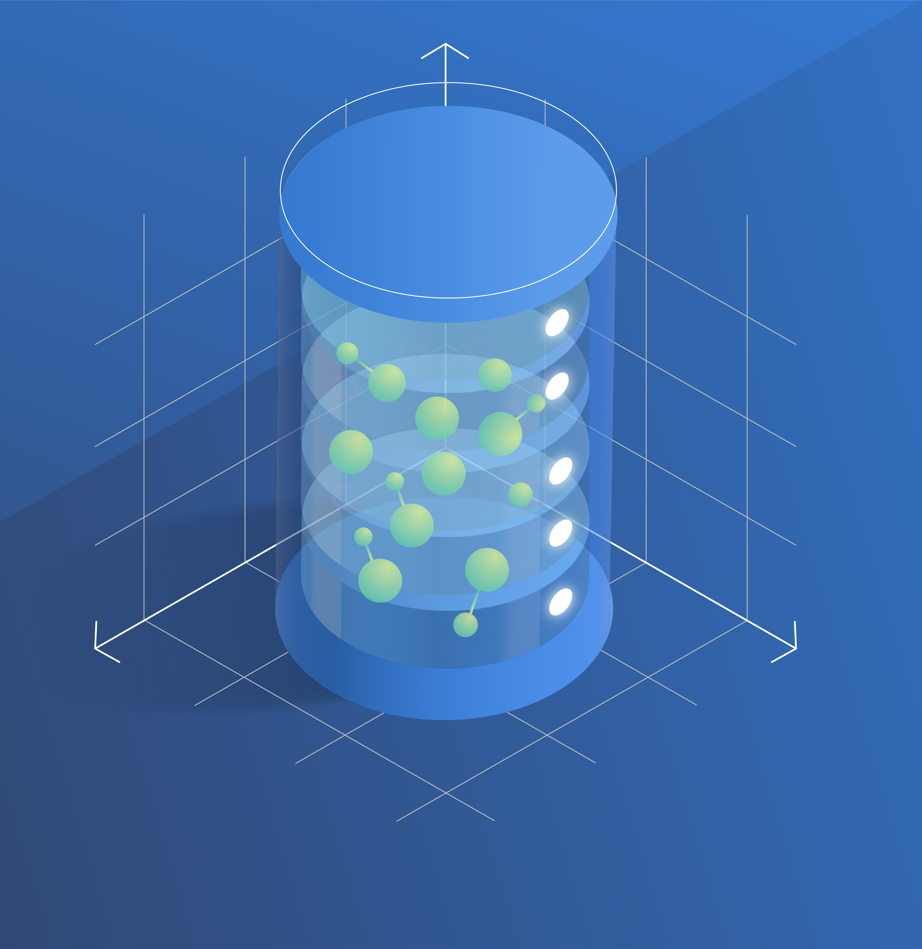
Vector Databases
Without vector search:
Question:
“Looking for lessons on underwater activities”
Won’t match:
“Scuba classes”​
“Snorkeling group sessions”​
Notes:
Vector databases have seen explosive growth with the rise in GenAI applications.
Vector-based retrieval is one way retrieval systems can find the right documents related to a prompt. It finds documents based on the semantic similarity, or the underlying meaning of a sentence, versus keyword overlap.
Vector databases have become extremely popular in GenAI stacks because of how useful vector search is at retrieving relevant information where the user provides a query in natural language (like a copilot or GPT).

Slide 6
Your retrieval strategy matters 1
More information ≠ better results
Accuracy
Number of documents provided
Source: Lost in the Middle: How Language Models Use Long Contexts, Liu et al. arXiv:2307.03172
Notes:
Now, there is a whole art to retrieval because the better the data retrieved, the better your application will be.
Turns out, you can’t just share a bunch of documents with an LLM and expect good results. LLMs were not built to find the most relevant information from your data. You need to be intentional with how you search your data.
This chart is from a research paper that studies how context length impacts the quality of responses. If you just cast a wide net where you retrieve a bunch of documents, put them in the prompt and hope the LLM will figure it out, you won’t get the best results. You need to make the retrieval system find the most relevant documents and only share those with the LLM.
So how do you do that?

Slide 7
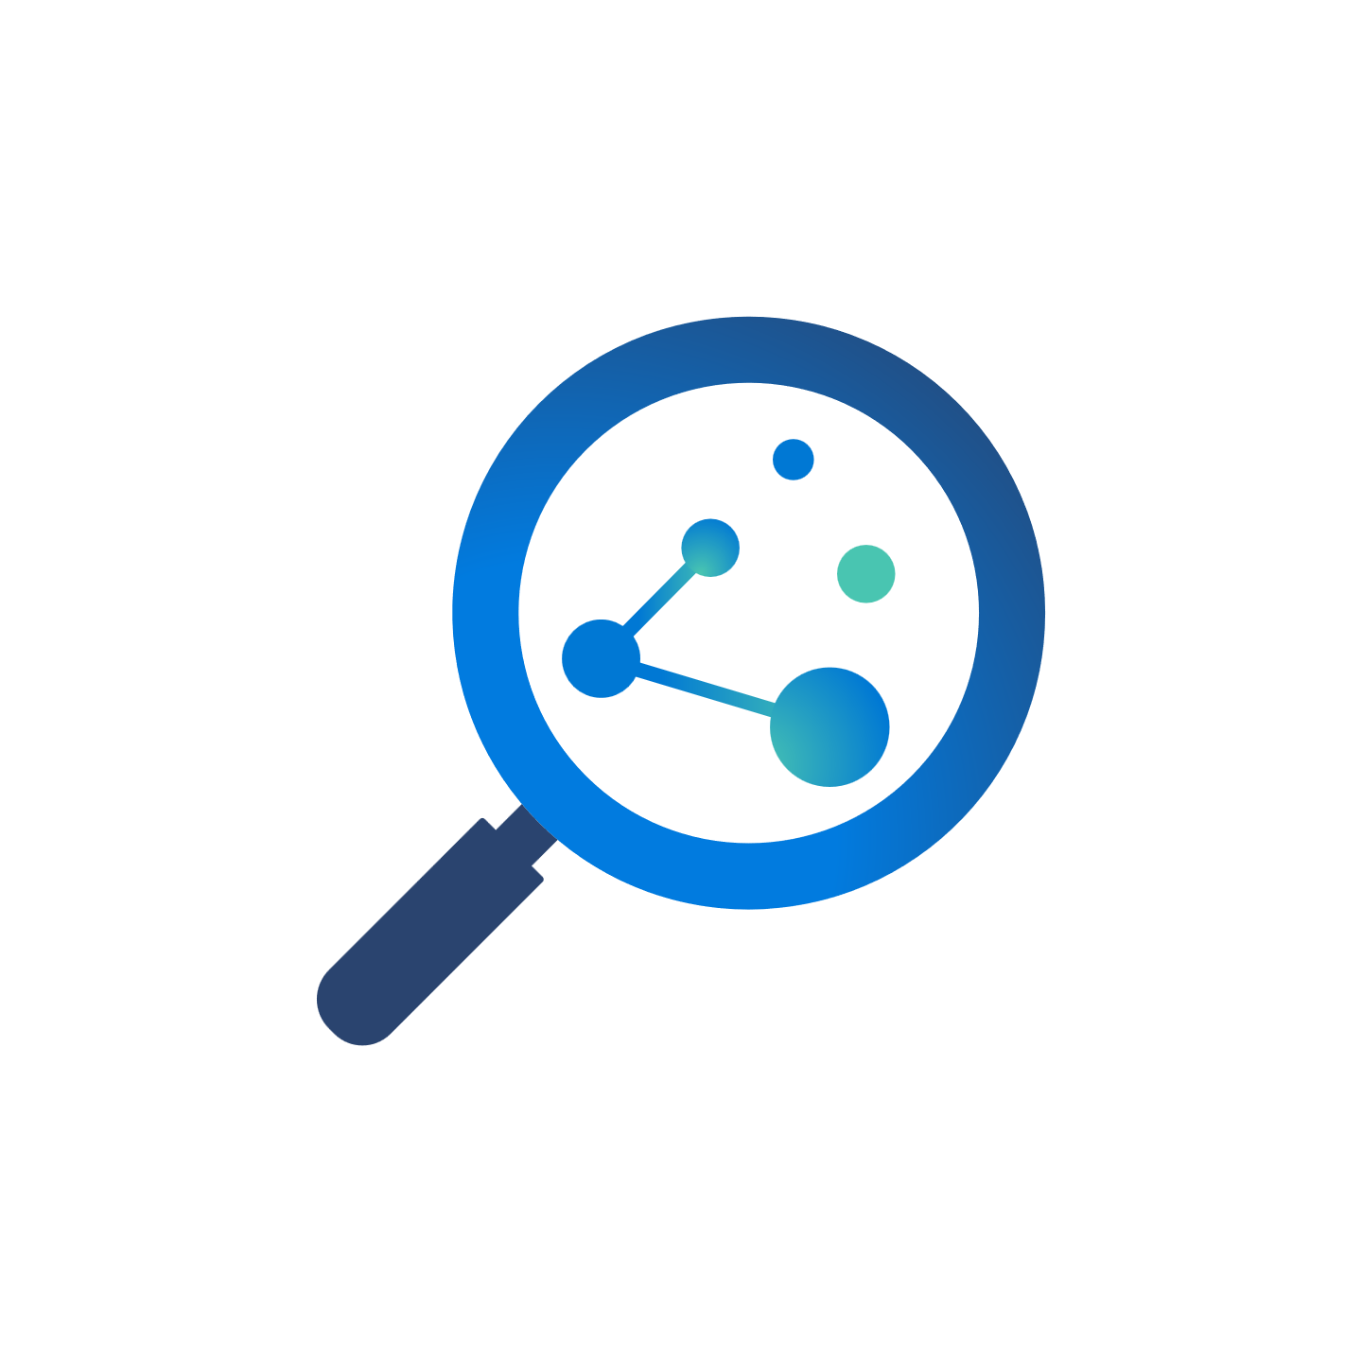



Retrieval strategies
Keyword search
Vector search
Hybrid search
Search re-ranking
For exact, plain text matches
“Vocabulary gap” in Q&A systems like Copilot
For conceptual similarity, or underlying meaning
Weak performance on exact matches (like a product ID or code)
Best of both vectors and keywords
Brings more accurate responses across various scenarios
Scores and ranks all retrieved documents by relevance
Reranking runs after performing search strategy (can’t retrieve information)
Notes:
While vector search is an extremely popular search strategy today, there are many other types of retrieval practices. Each practice is useful for particular needs and types of data.
The purpose of showing this view is to show how vector databases tie into RAG, but also show that there are a lot of different ways to retrieve your data – it’s not just vector search.
(Optional information – don’t speak to the below bullets)
Vector search is a popular retrieval strategy in GenAI apps
Challenges: Weak performance on exact matches and out-of-distribution data
Vector search retrieves stored matching information based on conceptual similarity, or the underlying meaning of sentences, rather than keyword matches.
Particularly useful for apps using dialogue and question/answering formats which is why vector search is so popular with the rise of gen AI applications
in addition, generative AI applications often interact with data beyond text. You may need to search through text, documents, images and audio to get the response you need to generate. Having your data represented as vectors turns all your heterogeneous data iVector search is a popular retrieval strategy in GenAI apps
Robust to variation in how concepts are articulated (morphology, specificity, etc.)
Keyword search
Keyword search is a concept most are familiar with: it searches for exact plain text matches included in the query. This type of search is still useful today, however it falls short in generative AI scenarios. For example, with question and answering systems (like ChatGPT), very often questions and their answers don’t have overlapping keywords to match on.
Challenges: vocabulary gap, gets worse with natural language questions nto the same type of searchable content.
Exact keyword based
Relevance via Boolean Search
Ranking via BM25
Reranking
Ranks retrieved documents in order by relevance in a normalized, calibrated search score
Identify good & bad candidates​
Exclude documents below a threshold​
​Complete search stacks do better:​
Hybrid retrieval (keywords + vectors) > pure-vector or keyword​
Hybrid + Reranking > Hybrid​
​

Slide 8
Better results with a robust retrieval system
Retrieval comparison using Azure AI Search in various retrieval modes on customer and academic benchmarks
Source: Outperforming vector search with hybrid + reranking
Notes:
https://techcommunity.microsoft.com/t5/azure-ai-services-blog/azure-cognitive-search-outperforming-vector-search-with-hybrid/ba-p/3929167
We ran tests to evaluate what retrieval strategies worked best, on customer data and on public datasets.
For these datasets, applying a combination of search strategies generally, specifically hybrid search and reranking is more likely to deliver better results than using one of these search strategies on their own.
You can read more about our findings in our blog post.

Slide 9
RAG Takeaways
Knowledge with RAG
Incorporate domain-specific knowledge into your GenAI app
Retrieval matters
A retrieval system delivers better information, you can’t rely on the LLM
Better results with robust search
Using multiple search strategies will retrieve more relevant information
Notes:
To wrap up our overview of RAG, I’m going to close out with some key takeaways to leave with.
RAG is all about incorporating domain knowledge into your GenAI application
Your retrieval system matters – the better the information retrieved, the better your app will be
You will get the best results from a retrieval system that can apply a combination of search strategies – it will fall short if you only rely on vector search or keyword search.

Slide 10

Azure AI Search
Feature-rich vector database
Seamless data & platform integrations
State-of-the-art search technology
Enterprise-ready foundation
Notes:
Today we are going to talk about how Azure AI Search helps you run superior, advanced RAG for better GenAI applications.
Azure AI search provides customers with a feature rich vector database built on an enterprise ready foundation, so you can focus on exponential growth and scale.
Its integrations offer an end-to-end data management pipeline for all types of data, a full-stack RAG solution available where and how you want to build.
Your retrieval strategy matters. Our comprehensive search technology goes beyond vector search, we ensure you have the capabilities you need to retrieve accurate information for every question, regardless of your use case or data.

Slide 11
Azure AI Search Revolutionary retrieval
Quality
Build better apps with better search
Agility
Flexibility with integrated platform and ecosystem
Scale
Perform RAG at scale with an enterprise-ready platform
Notes:
Here’s why customers use AI Search as their retrieval system in their RAG apps.
AI Search provides a comprehensive set of search technology, to pull the right information for every interaction, and delivered with built-in best practices, out of the box.
From data sources to processing to end-to-end app development, Azure AI Search offers development and deployment options so you can manage your stack easily in any environment, with any data, at any volume.
We support customers at any scale with our enterprise-ready foundation, with built-in protection, compliance and control over your data.
Let's walk through how Azure AI Search empowers customers to scale, build better AI experiences and stay agile.

Slide 12


Top Use Cases
Conversational search & insights
Better knowledge mining
AI assistant
Better analytics and service
Automation
Data and document processing
Content generation
Personalized recommendations

Slide 13

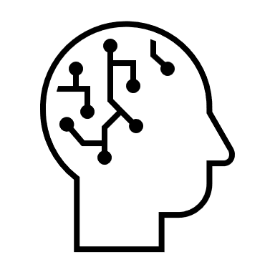
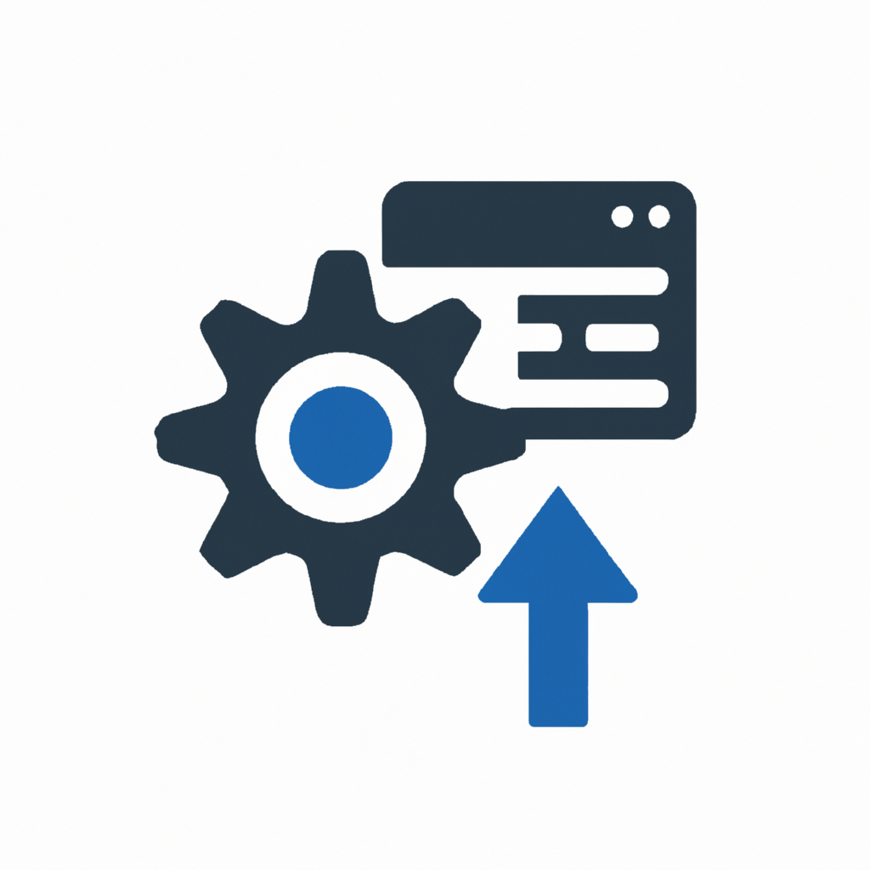
Azure AI Search
Revolutionary Retrieval
Deliver the best experience for every user and interaction, at any scale
Feature-rich vector database
Optimized vector storage in preview
Seamless data & platform integrations
State-of-the art search technology
Enterprise-ready foundation
Increased vector capacity per dollar

Slide 14


Built for quality
Better applications with state-of-the-art search technology
Customer support & conversational knowledge base
Personalized recommendations for marketing content
Notes:
Let’s talk about quality.
When using RAG, the application is only as good as what data is retrieved. The better the data retrieved, the better the application.
When we say Azure AI Search is built with quality in mind, we incorporate a broad span of retrieval capabilities, including vector, hybrid and multi-vector search, so that your application is incorporating the right data, that makes sense for every user interacting with your application.
With Azure AI Search, you are equipped with a state-of-the-art retrieval system that gives you the search technology needed to build better apps.

Slide 15
Retrieval-augmented generation
Retrieval system
Data Sources
User question
Answer
App UX
Orchestrator
Large Language Model
Notes:
If you’re going to use your own data in your GenAI app, Azure AI Search acts as the retrieval system in your RAG architecture: It incorporates the most relevant, domain specific knowledge for every query, so your application provides the responses you expect.
A common way to describe RAG is that you are “grounding” your AI application with your data.
If you are building an app using an AI model, you probably want to create an experience based on your own data, versus public web data. RAG is a way to incorporate your data into your GenAI application.
Out of the box, an AI model has a limited set of knowledge. RAG enables your app to learn new facts or knowledge outside what the model was originally trained on. This way, your app isn’t limited to a static/outdated dataset.
An important point to note, that with RAG, the knowledge you provide is externalized, and not incorporated into the model itself. This ensures you remain in control of your data, at all times.
When implementing RAG, a critical component is the "Retrieval system" which surfaces the right information from your data, that's needed to answer any particular question or interaction.
From there, you use the language model like Azure OpenAI GPT to apply reasoning and produce a relevant response.
When customers build their GenAI applications, Azure AI Search is used as the "retrieval system" in their RAG stack.

Slide 16
Better results
with a robust retrieval system
Notes:
You can’t rely on one search strategy like vector search and expect your application to perform the way you intended. Complete stacks work better: meaning you need to have a lot of various capabilities at your fingertips to ensure your app “just works.”
https://techcommunity.microsoft.com/t5/azure-ai-services-blog/azure-cognitive-search-outperforming-vector-search-with-hybrid/ba-p/3929167
We ran tests to evaluate what retrieval strategies worked best, on customer data and on public datasets.
For these datasets, applying hybrid search and reranking was more likely to deliver better results than using one of these search strategies on their own.

Slide 17
Robust retrieval technology
Vector Search (ANN) |  | Vector Search (KNN)
Hybrid Search (RRF) |  | Multi-vector search
Search reranking (BM25) |  | Multi-lingual search
Exact keyword match |  | Geospatial search
Facets |  | Auto-complete
Notes:
Azure AI Search has been in information retrieval for a long time, and over the years we continue to expand available search capabilities to our customers. Search & retrieval has always been our focus, and we take pride in offering a comprehensive, robust search stack.
The point of this slide is not to dive into every feature, but showcase the variety of capabilities we offer: it doesn’t stop at search capabilities like vector search and hybrid search. There is also pre/post metadata filtering, ranking search documents in priority order and support for 56 languages.
Information retrieval is why Azure AI Search exists, with or without GenAI, and customers can build apps on years of product development and search technology at their fingertips.

Slide 18

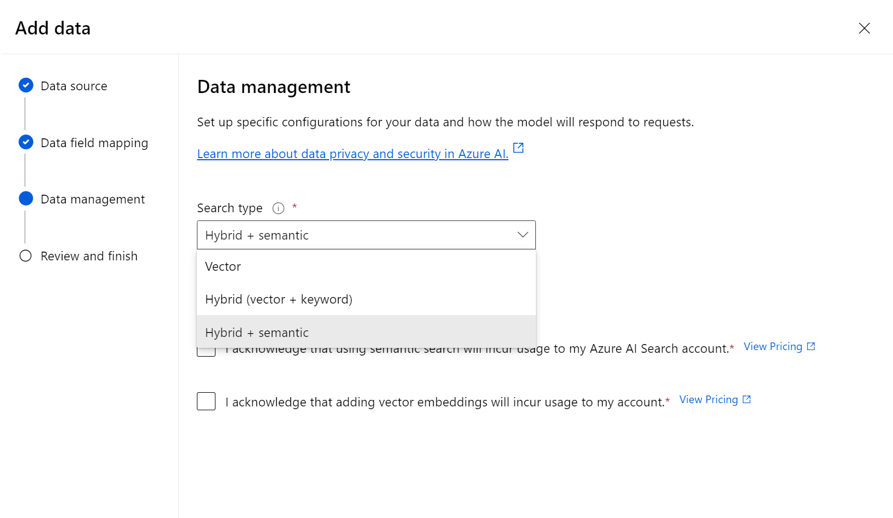
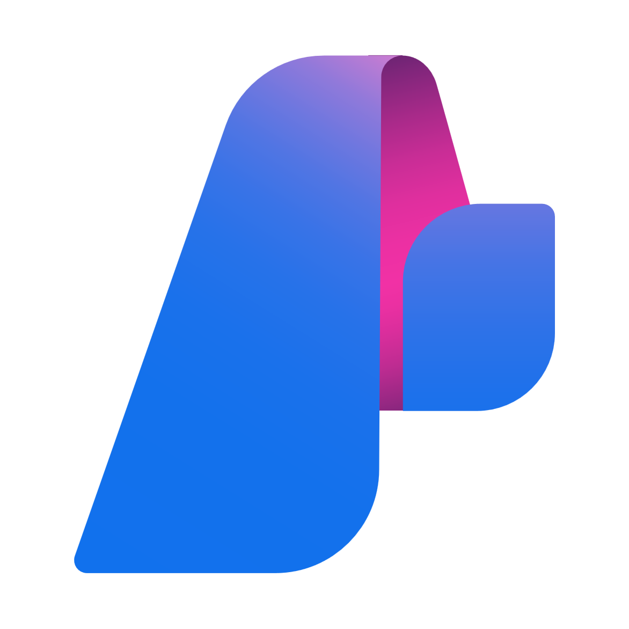
Apply search best practices
out of the box
Notes:
Finally, we take all of that testing and customer validation, and built those learnings into the product, so you don’t have to do the heavy lifting. We turn our learnings into simple actions, so you are equipped with the best search strategies immediately, without the need to do a bunch of configuring

Slide 19


Telus Health and NIQ Brandbank
Telus Health
Hybrid + reranking for customer care app
NIQ Brandbank
Multi-modal and multi-vector
Notes:
The following are two customers who required multiple search strategies just so their app performed as it was designed.
More on these two customers here: https://aka.ms/AISearch-RAGatScaleblog
We also have a demo that shows how much better your quality gets as you implement hybrid search and reranking: https://microsoft-my.sharepoint.com/:v:/p/mcasalaina/Ed31kGW76wtMtj6yl5ngP84Ba8tKpXJdlV-paZcYxyQQCg?e=jUoeK6v

Slide 20


Giving grocery retailers a competitive edge
Azure AI Search allows us to use hybrid multi-vector search, using text and image embeddings with semantic ranking to promote the most semantically relevant products to the top.
Azure AI Search is exactly what we needed to make the Content Health+ application a reality.
Gabriel Harris
Principal Data Scientist
NIQ Brandbank
Get the full story

Slide 21

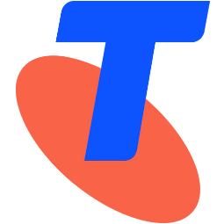
Flexible development
Deploy your way with deep platform and ecosystem integrations
Audit process automation
& RAG
Customer support
& AI assistant
Notes:
Azure AI Search offers various development and deployment options so you can manage your stack easily in any environment, with any data, and at any volume.
We help you move from idea to production fast with deep platform and data integrations, across data sources, LLMs and OSS frameworks for agile development and rapid scale.

Slide 22
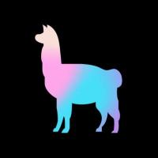
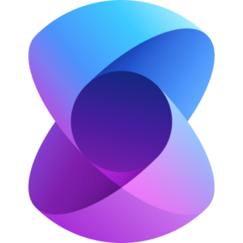
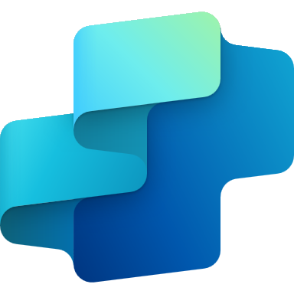
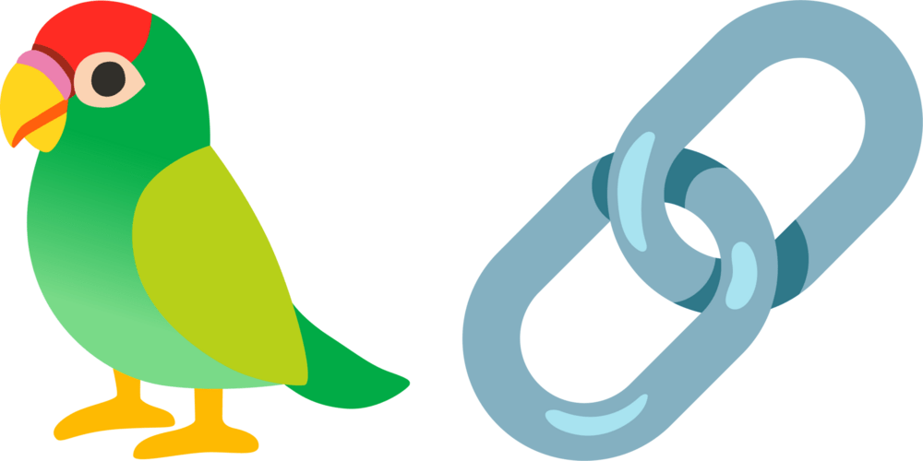









Seamless integrations for your GenAI deployments
Llamaindex
Semantic Kernel
Copilot Studio
Langchain
Azure AI Studio
Orchestration
OneLake
SQL DB
Data Lake
Storage Gen2
Blob storage
Azure AI Search
Azure OpenAI
Azure Machine Learning
AI Services
Table storage
Azure Cosmos DB
Models
Data
Automated data ingestion for supported data sources
Streamlined vector processing:
ingest, chunk, enrich, vectorize in one pipeline
Data preparation, processing & indexing
Notes:
Out of the box indexing to accelerate data processing pipeline:
Use indexers that connect to supported Azure & third-party data sources to automatically upload data into your index
For supported data sources, automatically perform data chunking and vectorization upon ingestion, eliminating extra steps and tools required.
Develop your way and choose how and where you want to build:
Use Azure AI Search via SDKs, AI Studio, Copilot studio, or OSS frameworks – wherever you need to get your RAG up and running.
SDK for JavaScript (with support for NodeJS and Typescript), Python, .NET, Java
Accessible through OSS frameworks Langchain, Semantic kernel and Llamaindex
Code samples and repos to get up and running quickly
Run full-stack RAG with a native LLM integration with Azure OpenAI Service, or through Azure Machine Learning as a vector store:
native LLM integration for full-stack RAG solution out of the box
Use Azure AI Search as a vector store for RAG within Azure Machine Learning

Slide 23
Seamless integrations for GenAI deployments
Data
Automated data ingestion for supported Azure and 3P sources
Streamlined vector indexing ingest, enrich, chunk & vectorize in one pipeline
Models
Azure OpenAI on your data
Azure Machine Learning Prompt Flow
Azure AI services
Orchestration
Semantic Kernel
Langchain
Llamaindex
Azure AI Studio
Copilot Studio
SDK for JavaScript, Python, .NET, Java
CLI
Notes:
At every step of the way, Azure AI Search offers seamless integrations built to support GenAI deployments.
Data:
With indexers that connect to supported Azure data sources to automatically upload your data into your index
For data like vectors, we also simplify the indexing pipeline by automatically performing chunking and vectorization upon ingestion, in one flow, eliminating extra steps and tools.
Models:
Run full-stack RAG using native LLM integrations with Azure OpenAI Service for the latest OpenAI models, and Azure Machine Learning to run RAG with your own custom models
Orchestration:
Build out your application using OSS frameworks or in platforms like Copilot Studio and Azure AI Studio – you choose how and where you want to build

Slide 24

Integrated vectorization
Data source access
OneLake
Blob Storage
ADLSv2
SQL DB
CosmosDB
Incremental change tracking
File format cracking
PDFs, Office docs
Image files
Nested images in PDFs, Office docs
Chunking
Split text into passages (for text portions)
Propagate document metadata
Vectorization
Image → vector
Text → vector
Embeddings from OpenAI, AI Vision, or custom models
Indexing
Document index
Chunk index
Both

Slide 25


PWC and Telstra
PWC
Azure Cosmos DB, Azure OpenAI, Azure Kubernetes
Telstra
Azure OpenAI and Azure Machine Learning
Notes:
Both PWC and Telstra are great examples of customers who’s architecture makes the most of Azure AI Search’s integrations to run RAG and support their organizational goals.
PWC: FULL CASE STUDY https://customers.microsoft.com/en-us/story/1702043495902005748-pwc-azure-openai-service-united-kingdom
PwC uses Cosmos to store chat history generated by the application, Azure AI Search as the retrieval system for their RAG and AKS to host their app
Telstra: https://customers.microsoft.com/en-us/story/1740058425924206437-telstra-telecommunications-azure-openai-service

Slide 26
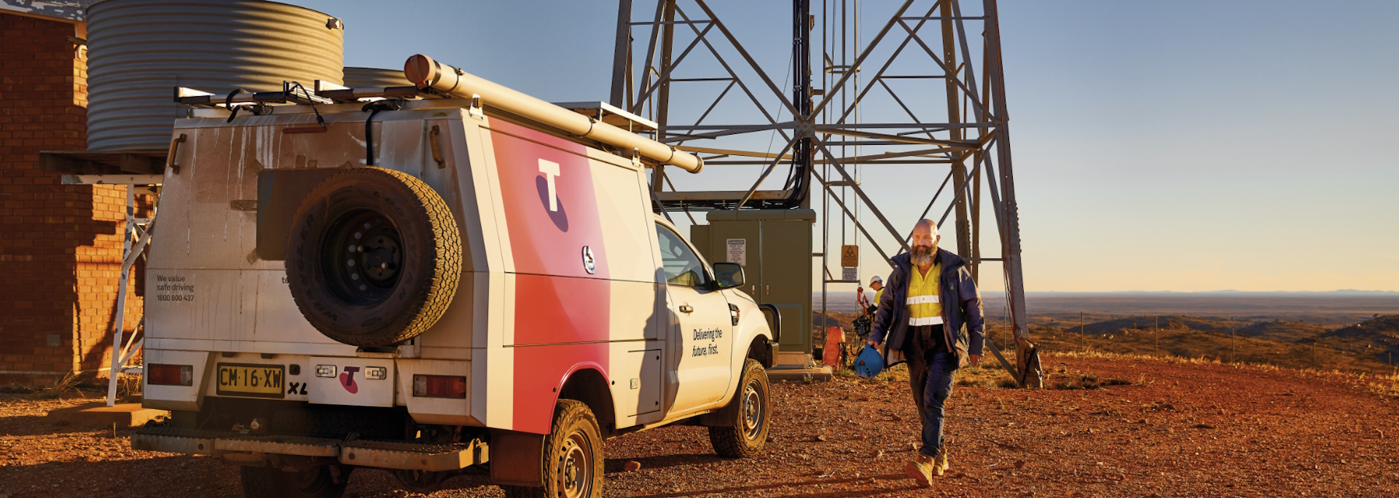
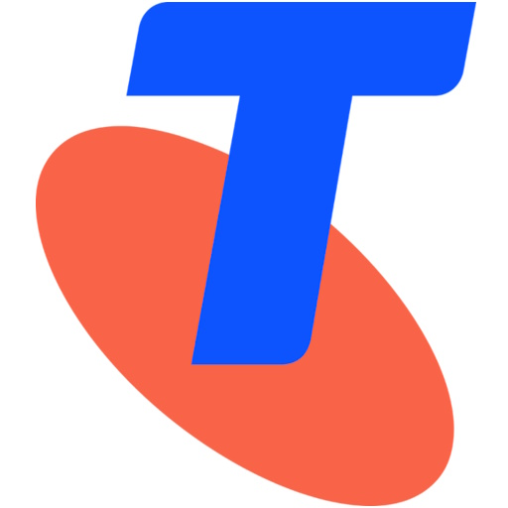
Telstra
Customer: Telstra
Industry: Telecommunications
Size: 10,000+ employees
Country: Australia
Products and services: Azure OpenAI Service Azure AI Search Azure Machine Learning
Read full story here
“90% of customer service agents who tested One Sentence Summary increased their effectiveness, their calls required 20 percent less follow-up than those handled without the tool.”
—Rohit Lakhotia, General Manager of Customer and Channel AI, Telstra
When Telstra wanted to improve customer service, it considered how to reduce the need for consumers to repeat their queries to staff, as well as supporting customer service agents with a faster and easier way to find answers to customer queries. .
Telstra turned to Azure OpenAI Service, Azure AI Search, and Azure Machine Learning as the platforms on which to create two tools: Ask Telstra, which puts technical information at the agents’ fingertips, and One Sentence Summary, which instantly brings agents up-to-speed on customer history.
Telstra’s trials of the AI-enabled tools achieved impressive results: 90 percent of customer service agents using One Sentence Summary saved time and increased effectiveness, reducing follow-up contact by 20 percent. The stage is set for AI-enhanced processes.
Notes:
When Telstra wanted to improve customer service, it considered how to reduce the need for consumers to repeat their queries to staff, as well as supporting customer service agents with a faster and easier way to find answers to customer queries. .
Telstra turned to Azure OpenAI Service, Azure AI Search, and Azure Machine Learning as the platforms on which to create two tools: Ask Telstra, which puts technical information at the agents’ fingertips, and One Sentence Summary, which instantly brings agents up-to-speed on customer history.
Telstra’s trials of the AI-enabled tools achieved impressive results: 90 percent of customer service agents using One Sentence Summary saved time and increased effectiveness, reducing follow-up contact by 20 percent. The stage is set for AI-enhanced processes.

Slide 27


PwC
LinkedIn Post:
https://www.linkedin.com/mycompany/microsoft/recommendations/urn:li:activity:7137842065765236737
Customer: PricewaterhouseCoopers (PwC)
Industry: Professional Services
Size: Corporate (10,000+ employees)
Country: United Kingdom
Products and services: Azure OpenAI Service Azure Cosmos DB Azure Kubernetes Service
Read full story here
“Whether it's enhancing the search experience for practitioners or leveraging RAG techniques to summarize documents or automatically generate agendas, it's really only the tip of the iceberg.”
— Winnie Cheng, Director of AI, PwC Next Generation Audit
To maintain its position of leadership for years to come, PwC identified the need to modernize its auditing solution. The new solution would take advantage of cloud and AI technologies in order to better uncover insights from unstructured data.
Next Generation Audit will make use of Microsoft Azure OpenAI Service, Azure AI Search, multiple other Microsoft cloud and AI solutions to deliver its broad capabilities around the world with Azure global infrastructure.
PwC, in collaboration with Microsoft, is creating the next generation of auditing technology not only to better serve its clients and deliver an improved experience for its employees, but to elevate the capabilities of its sector as a whole.
Notes:
FULL CASE STUDY (and image source)
A great example of applying RAG to a high-quality GenAI experience is PWC.
PricewaterhouseCoopers is among the leading professional services networks, offering accounting, auditing, human resources and more…
They needed to simplify their auditing process in a way that felt effortless for their clients.
They needed technology to work harder in the background and basically get OUT of the way.
Through the combination of Azure OpenAI Service and Azure AI Search, PWC was able to develop their ‘Next Generation Audit’ application.
With Azure, they turned petabytes of data across tens of thousands of clients into secure, efficient and actionable insights at a massive scale.

Slide 28


RAG at scale
Build a multi-billion vector index in one service
RAG for Chatbots (like ChatGPT) and chatbot tools
Enterprise search & RAG
Notes:
Let’s talk about scalability. In 2023, everyone built a proof of concept. This year, these apps are going into production, and your app needs to be built to scale.
Not only that, we are seeing new advances and trends that will also require larger scale. For example, Memory is a popular trend to apply in AI applications, where the app can remember previous interactions the user had to influence its responses. Trends like these will require more capacity and capabilities like multi-tenant support.
Over half of the Fortune 500 trust Azure AI Search for their enterprise applications, thanks to its ability to scale, handle massive workloads and ensure enterprise-grade resilience at any volume.
With Azure AI Search, we support the ability to build a multi billion vector index in one service with our increased vector capacity and compute. With our enterprise ready platform and vector database, we support production at scale and accomplishing your AI goals.

Slide 29

Vector database built for enterprise scale
Full-featured
Create embeddings using any model
Explicit and transparent vector data processing
Exhaustive KNN search​ & ANN search
Multi-vector
Notes:
Vector databases are extremely popular in the GenAI market, and so for customers who want to understand whether we are a vector database – we tick all of those boxes and more.
In addition to our various search capabilities available, Azure AI Search offers streamlined vector data processing,
Data management
Build a multi-billion vector index in a single service without compromising performance or cost, with a market leader in vector capacity.
Data processing and preparation:
Streamlined indexing with data enrichment to gain insights and draw connections from any form of data
Support low latency requirements with push model that has no restrictions of data source type, frequency and in your control.
Use indexers to automatically upload data with native Azure data platform integrations and third-party connectors
Explicit and transparent vector data processing
Enrich and extract meaningful insights from all aspects of your data with accessible, market-tested AI models on demand.
Automatically process images, natural language, documents and text during ingestion, to extract, enrich and structure data with further meaning and utility.
Query with similarity search and hybrid search, multi-modal, multi-vector to surface relevant results across text, images, audio and video data.
Query-time vectorization support: Use a vector as a query directly, or provide the query text and Azure AI Search will automatically use the configured embedding model to vectorize it for you
Support multimodal search, such as images and text by creating multi-vector queries and multiple vectors per document
Limit vector searches with metadata filtering, applied pre or post query execution
Support for Exhaustive KNN and approximate-nearest-neighbor search for both comprehensive and fast processing.
Store
store vectors to serve as long term memory or an external knowledge base for LLMs
Document size
Vector dimensions
Multi-tenant

Slide 30
Enterprise-ready platform
Data encryption
Authentication
Network security
Data privacy
Compliance
Notes:
Enterprise-readiness is a critical component to ensure scalability and protect production ready applications.
Focus on exponential growth using an enterprise-ready vector database and platform with built-in security, compliance and responsible AI practices.
Network security & isolation: Build on one of the largest interconnected networks in the world and protect your service network from public access with your own private virtual network or IP firewall rules.
Identity Authentication: Secure service access and connections between services using built-in RBAC and managed identities
Data privacy: You own your data, and it will always remain in your control. It is never used to train models, it’s protected by privacy laws such as GDPR and ISO/IEC 27018, and you decide where it resides.
Data protection: Protect your data at rest, in transit and in use with advanced encryption built in, and the option to supplement with customer-managed keys (CMK)
Compliance: Streamline compliance with over 100 global offerings, the most comprehensive compliance coverage of any cloud service provider, spanning healthcare, government, IT, and financial services
Responsible AI:
Build AI apps responsibly with built-in tools like Azure AI Content Safety for content moderation and the responsible AI dashboard in Azure Machine Learning platform.

Slide 31


OpenAI and Dataverse
OpenAI
Powering massive, internet-scale RAG workloads with Azure AI Search
Dataverse
Global-scale enterprise retrieval for search and RAG experiences
Notes:
Dataverse: Search & Copilot​
Global-scale enterprise retrieval powering search and RAG experiences​
10s of billions of entities, 100s of 1000s of indexes, world-wide footprint​
OpenAI​
Internet-scale RAG for consumer and enterprise scenarios:
https://aka.ms/AISearch-RAGatScaleblog

Slide 32

More storage, lower cost, high performance
Up to 10x+ increase in vector index size per partition: now the amount of vector data you can store surpasses previous total storage limits
Up to 6x increase in total storage limits per partition
More compute capacity per unit to support extra volume of vectors at high performance
Now available
Notes:
In April 2024, we announced increased storage capacity and vector index size for Basic and Standard tiers. This will significantly lower the cost of Azure AI Search, especially when growing your workloads. For more information, check out our blog
https://aka.ms/search-capacity-launch
New services in the Basic and Standard tiers in select regions now have more storage capacity and compute for high performance retrieval of vectors, text, and metadata. On average, cost per vector is reduced by 85% and you’ll save on total storage costs per GB by up to 75% or more. For example, in an S1 search service you can store 28M vectors with 768 dimensions for $1/hour, a savings of 91% over our previous vector limits.
New services will have:
3x to 6x increase in total storage per partition
5x to 10x increase in vector index size per partition
Additional compute backing the service supports more vectors at high performance and up to 2x improvement in indexing and query throughput.

Slide 33
AI Search
Azure
Azure
Feature-rich vector database
Seamless data & platform integrations
State-of-the-art search technology
Enterprise-ready foundation
Notes:
Azure AI Search supports app quality, scale and agility through our state of the art search, full-featured enterprise-ready platform and end to end integrations.
We have everything you need to build superior RAG applications on Azure.

Slide 34
Momentum and beyond GenAI
Vector search
Keyword search re‑ranking
AI-powered content understanding
Language expansion
Keyword search
Notes:
As mentioned earlier, Azure AI Search has been in information retrieval for a long time, before Generative AI. We first focused on cutting edge full-text search, to support enterprise search use cases. From there we expanded and made it possible to incorporate pre-built AI models from Azure AI Services to make unstructured data easy to search. Then, we incorporated technology from Bing to improve full-text search relevance. Last year we released vector search and hybrid search, and we are excited to see where AI takes us next.
Search & retrieval has always been our focus, and it will remain that way, so we can support you by providing leading search technology and best practices for any use case.

Slide 35



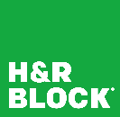
RAG to ROI
Conversational search & insights
Content generation
AI assistant
Automation
Boehringer Ingelheim
“For each document, it provides all metadata, including the author’s name, topic areas, and a brief summary.”
-Aleksandar Kapisoda, Senior Knowledge & Learning Scientist at Boehringer Ingelheim
Telstra
“New agents found that Ask Telstra gave them a big boost to becoming more effective, faster.”
-Rohit Lakhotia, General Manager of Customer and Channel AI at Telstra
Aprimo
“The findability of assets within Aprimo’s DAM solution is unmatched. The AI and meta-tagging capabilities make it so easy for any team to quickly locate the files needed for projects.”
-Kevin Souers, CPO at Aprimo
HR Block
“Accessing useful information quickly is critically important to providing a differentiated client experience, which is why we use Azure AI Search.”
-Aditya Thadani, Vice President at H&R Block
Notes:
https://customers.microsoft.com/en-us/story/1693653851333576209-boerhingeringelheim-azureopenaiservices-en
https://customers.microsoft.com/en-us/story/1740058425924206437-telstra-telecommunications-azure-openai-service
https://customers.microsoft.com/en-us/story/1647646542947823380-aprimo-professional-services-azure-openai-service
https://customers.microsoft.com/en-us/story/1540735146173684481-hr-block-professional-services-azure-form-recognizer

Slide 36
Resources
Github repo: Vector search code samples
Blog: How Azure AI Search outperforms vector search
OpenAI cookbook
Github repo: RAG accelerator

Slide 37

Automation innovation from H&R Block
Accessing useful information quickly is critically important to providing a differentiated client experience, which is why we use Azure AI Search.
Aditya Thadani H&R Block Vice President Architecture & Platform Engineering
30 million
The amount of tax documents H&R block will classify in per year with Azure app intelligence and scale
Get the full story

Slide 38
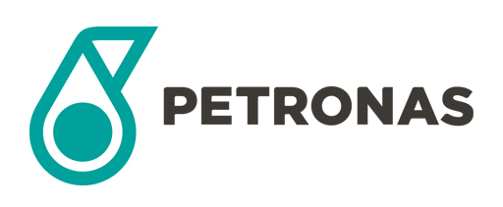

Petronas gets faster access to more relevant data
An employee used to spend hours searching for information. Now it happens immediately with just a few clicks.
Datin Habsah Nordin
Head of Enterprise Data
Petronas
16,000 employees
Number of employees using Data+, Petronas' self-service knowledge base, built with Azure AI Search and a knowledge graph, using natural language processing, automated tagging, and personalization to produce higher search accuracy
Get the full story

Slide 39
What’s new

Slide 40
Product Releases: what’s new
GA: Integrated vectorization – July 2024
GA: More capacity per dollar – May 2024
Preview: Fabric OneLake integration – May 2024
Preview: Embeddings via AI Studio model catalog – May 2024
GA: Vector and hybrid search features for reduced storage costs – July 2024
GA: Vector weighting for more relevant results – July 2024
Full list of vector and hybrid search features for more relevant results – May 2024

Slide 41
Integrated vectorization
Generally available
Data import
OneLake
Blob Storage
ADLSv2
SQL DB
CosmosDB
Incremental change tracking
Document cracking
PDFs, Office docs
Image files
Nested images in PDFs, Office docs
Chunking
Split text into passages (for text portions)
Propagate document metadata
Vectorization
Image → vector
Text → vector
Embeddings from OpenAI, AI Vision, or custom models
Indexing
Document index
Chunk index
Both

Slide 42
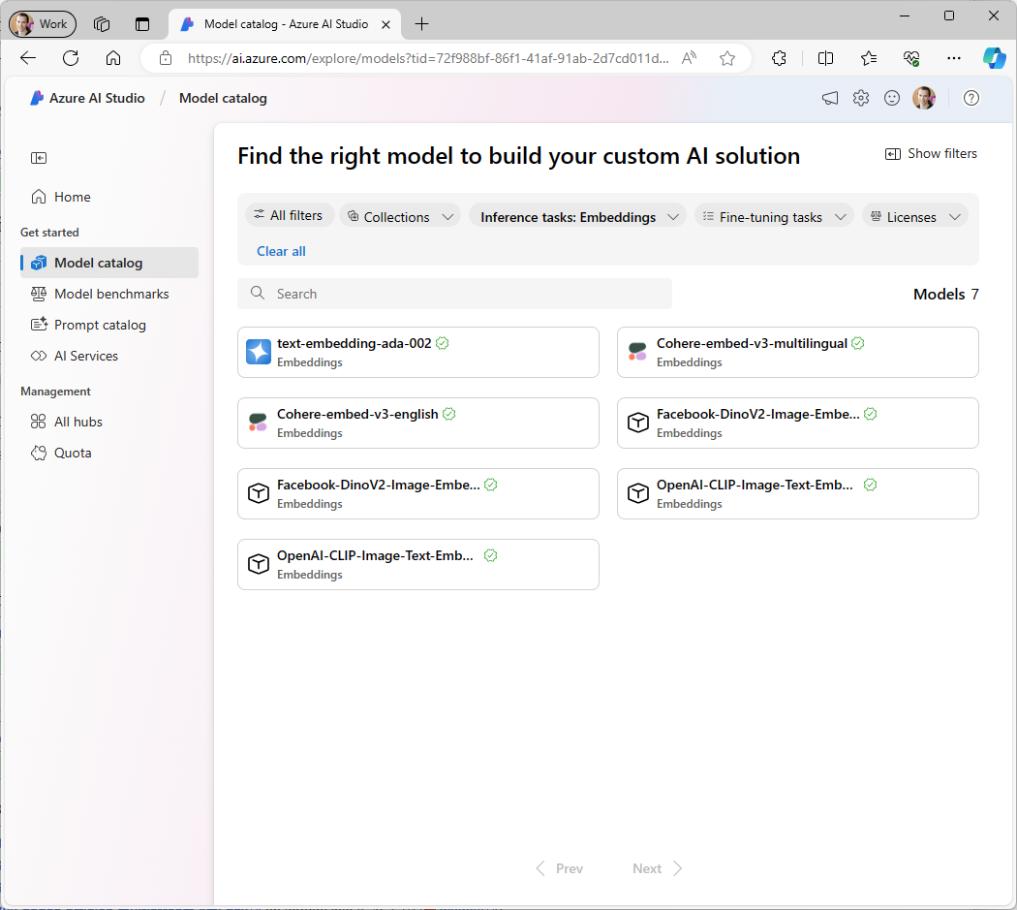
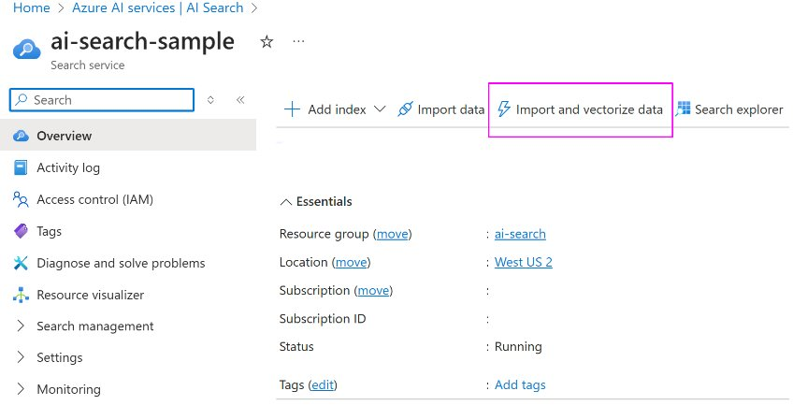
Integrated vectorization
Generally available
Simplifies development for RAG apps, enhancing efficiency​
Utilizes Azure OpenAI embedding models out of the box during data processing at indexing and query time​
Integrates data chunking, embedding, indexing and vectorization
PAYG pricing for Azure OpenAI embedding models

Slide 43
Integrated vectorization for streamlined development
Simplifies development for RAG apps, enhancing efficiency​
Utilizes Azure OpenAI embedding models out of the box during data processing at indexing and query time​
Integrates data chunking, embedding, indexing and vectorization
PAYG pricing for Azure OpenAI embedding models
Generally available

Slide 44
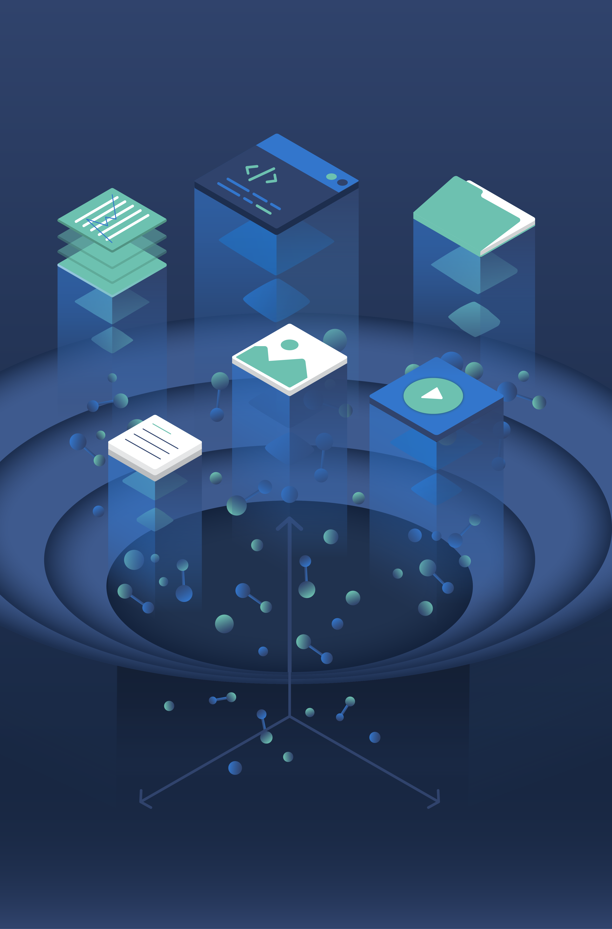
Launch RAG faster Integrated vectorization in Azure AI Search
Generally available
Overview
Streamline indexing pipelines and RAG workflows from source file to index query. Integrated vectorization incorporates data chunking and text/image vector conversions into one flow, enabling effective vector search across your proprietary data with minimal friction.
Included in GA release
Integrate vector index with Azure OpenAI embedding models out-of-the-box
Automatically chunk and vectorize text during your indexing process
Use index projections to support one-to-many indexing, helpful for chunking scenarios
Automatically vectorize queries using Azure to generate embeddings for text

Slide 45
Integrated Vectorization for Images
Preview
End-to-end support for image data
Extract images nested in PDFs, Office docs
Compute vector embeddings for images during ingestion using Azure AI Vision
Query directly with an image, or execute hybrid + multi-vector queries
Start in the Azure Portal: “import and vectorize data”
Data source access
OneLake
Blob Storage
ADLSv2
SQL DB
CosmosDB
…
Incremental change tracking
File format cracking
PDFs, Office docs
Image files
Nested images in PDFs, Office docs
Chunking
Split text into passages (for text portions)
Propagate document metadata
Vectorization
Image → vector
Text → vector
Embeddings from OpenAI, AI Vision, or custom models
Indexing
Document index
Chunk index
Both

Slide 46
Megastorage: increased capacity / compute
Announcing
Increased Vector, Storage, Compute Capacity
Same workloads can be handled with smaller tiers
Build billion-vector search services
Includes all the power of a full retrieval system
Details
Up to 12x increase in vector density increase
Up to 6x total storage limit increase
More compute capacity in most tiers
Applies to newly created services

Slide 47
Vector and hybrid search releases
Reduce storage costs
More relevant results
Binary & scalar quantization GA
Stored property GA
Narrow vector types GA
Hybrid & vector weighting GA
Support for binary vector types
Support maximum text recall size at query time in hybrid search
Support thresholding for vector queries​
Document boosting support for vector and hybrid search
50% decrease in query latency for hybrid search
Notes:
These new capabilities for vector and hybrid search, including vector weighting, score threshold control and allowing maximum text recall size, will give customers more options and flexibility to improve the accuracy of their responses. These features are in preview.

Slide 48
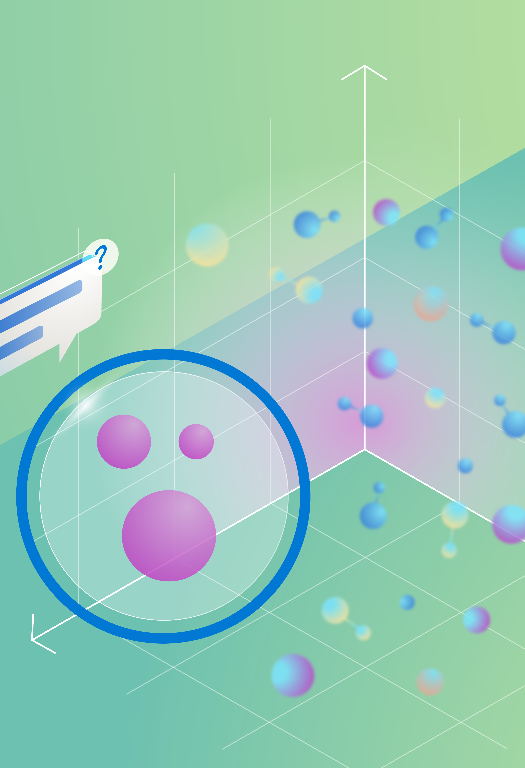
Reduce vector storage costs New capabilities in vector search
Generally available
Business value
New options for vector search available to control performance and reduce storage cost
Feature details
Use scalar and binary quantization to compress and optimize vector data storage. Reduces vector index size by up to 96% and vector storage on disk by ~25%.
Set the Stored property on vector fields to reduce vector storage overhead, with an expected storage reduction of ~50% for vector fields using exhaustive KNN and ~25% for vector fields using HNSW.
Use narrow vector field primitive types such as int8, in16, or float16, to reduce vector index size and vector storage on disk by up to 75%.

Slide 49

Pillar view: relevance updates
Azure AI Search
More hybrid and vector search capabilities to boost search relevance
Up to a 50% query latency improvement for hybrid search
Document
Boosting
Binary vector types
Score threshold filtering
Vector weighting
MaxTextSizeRecall for Hybrid Search
GA
aka.ms/build-search
Notes:
We're going to be offering 5,000,000 TPM as the default rate limit for all of our enterprise customers on GPT4o and industry leading latency at global scale for customers that are able to run on global endpoints, while also still making the model available in every region.

Slide 50
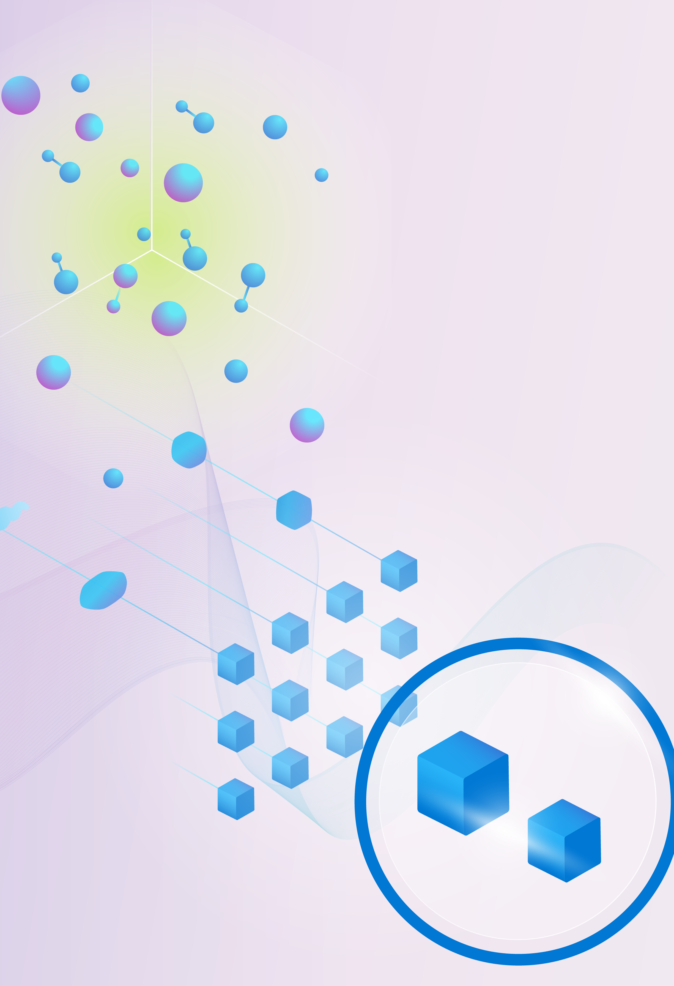
More relevant results with vector weighting
Generally available
Business value
Vector weighting offers a greater degree of control and precision in your search operations. With vector weighting, you can improve search results accuracy and relevance, thereby improving decision-making and operational efficiency.
Feature details
Specify relative weight (importance) of vector queries to term queries in hybrid search scenarios (e.g. prioritize vector similarity over keyword similarity)
The specified weights are used when calculating the scores of each document, giving you more control over the final result set.
Assign different weights to each vector to prioritize certain result sets and fine-tune the results to match specific needs.

Slide 51
More relevant results and enhanced performance Vector & hybrid search | Azure AI Search
Feature details
GA: Vector Weighting specifies relative weight (importance) of vector queries to term queries in hybrid search scenarios
Binary Vector Types to store and process embeddings with binary outputs such as Cohere Embed V3, allowing for larger vector datasets at a lower cost
Score Threshold Filtering filters out documents with low similarity scores before combining results from different recall sets
MaxTextSizeRecall for hybrid search enables ability to specify the maximum number of documents recalled in hybrid search queries from the keyword search recall set.
Document Boosting support for Vector/Hybrid Search enables prioritization of parameters such as freshness, geolocation, or specific keywords
Experience up to a 50% decrease in query latency for hybrid search with the latest set of feature improvements

Slide 52
Pillar view: Fabric Onelake integration
Azure AI Search
Integration with Fabric OneLake
Index unstructured content directly from OneLake
Shortcuts to third-party cloud storage
Integrated vectorization and chunking
aka.ms/AISearchOneLake
Notes:
We're going to be offering 5,000,000 TPM as the default rate limit for all of our enterprise customers on GPT4o and industry leading latency at global scale for customers that are able to run on global endpoints, while also still making the model available in every region.

Slide 53
Fabric OneLake for files integration
Preview
Index unstructured data directly from OneLake
Seamless indexing, enrichment and integrated vectorization
Shortcuts to AWS S3 and Google Cloud Storage

Slide 54
AI Studio model catalog integration for embeddings
Catalog includes embedding models
Deploy in AI Studio, connect to Azure AI Search for index/query-time vectorization
Includes models that use narrow types
Example:
Cohere’s RAG-focused model “Cohere-embed-v3-English”, supports float, int8, binary

Slide 55
Use more embedding models with new platform integrations
Multi-modal search with built-in image vectorization from Azure AI Vision
The latest Azure OpenAI embedding models
AI Studio model catalog embedding models
Preview

